Slide 2
Motivation
COVID-19
The Motivation

Slide 3
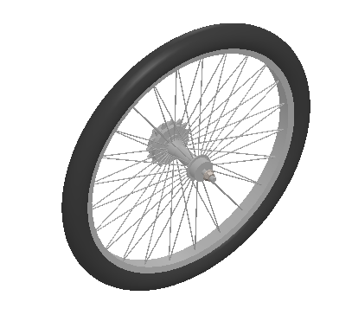
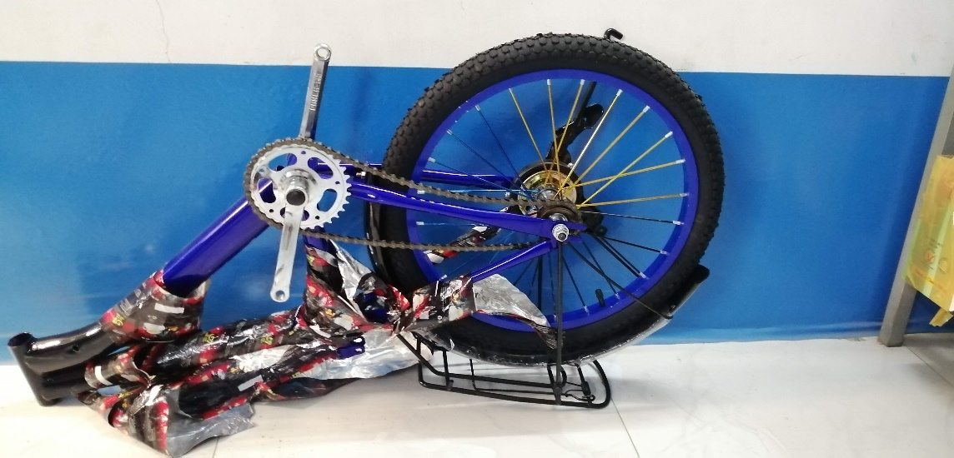

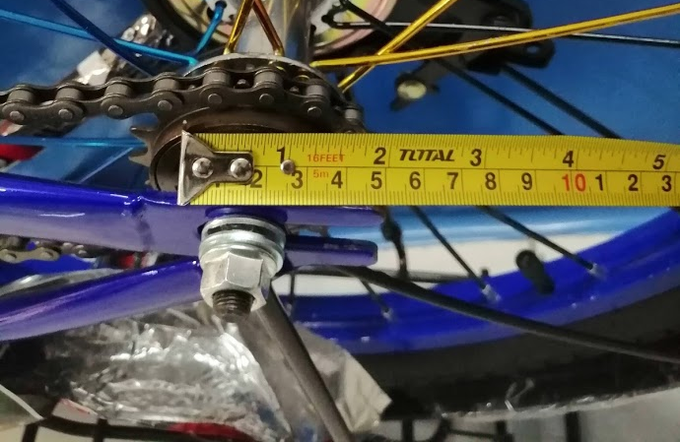
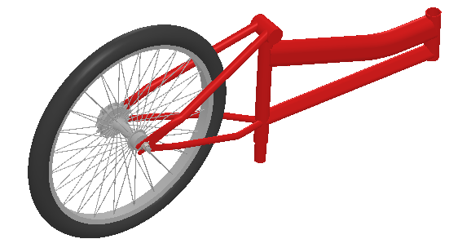
Why this System?
Motivation
+
Lắp ráp và siết ốc cho xe đạp

Slide 4
Design Objective
Motivation
“Design an
automated nut running system
for the back-wheel assembly of bicycles
using robotic arm
and computer vision..”

Slide 5
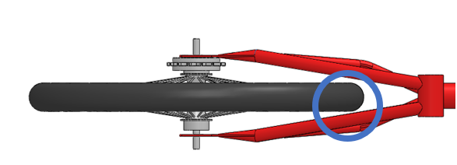
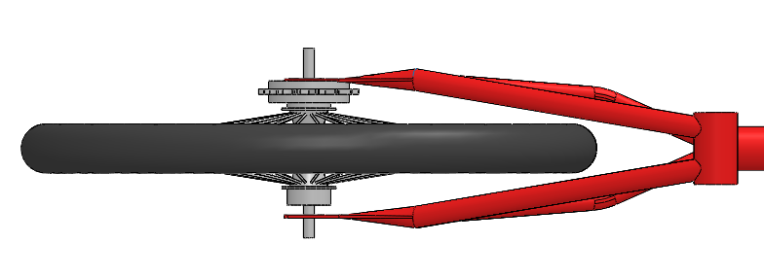
Design Scope (1/2)
Motivation
Output quality:
The wheel is centered.
The chain drive is tensioned.
Required tightening force: 46 Nm.
Productivity: 30 bikes per hour.
(a) OK
(b) NG
Illustration of OK and NG products

Slide 6
Design Scope (2/2)
Motivation
Input data: Bike’s dimensions
Notes:
Shaft: in black or silver and has M-10 thread.
Nuts: in silver, ISO 4161 M-10 type
Bike’s dimensions

Slide 7
System Design
SYSTEM DESIGN
An Overview

Slide 8
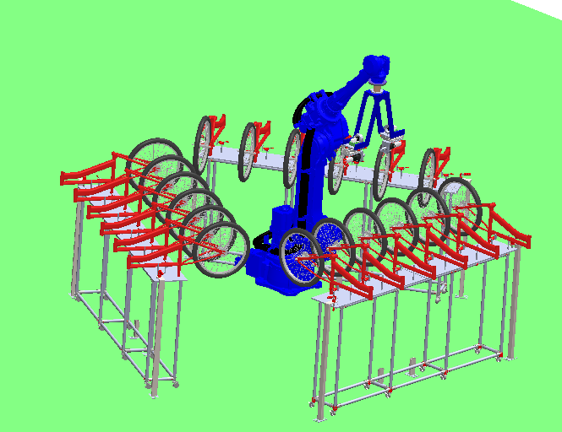
Workspace Setup
System Design
Robot’s Tool
Mounting Cart

Slide 9
Simplified Diagrams
System Design

Slide 10
The Workflow
System Design
My golden star !!!

Slide 11
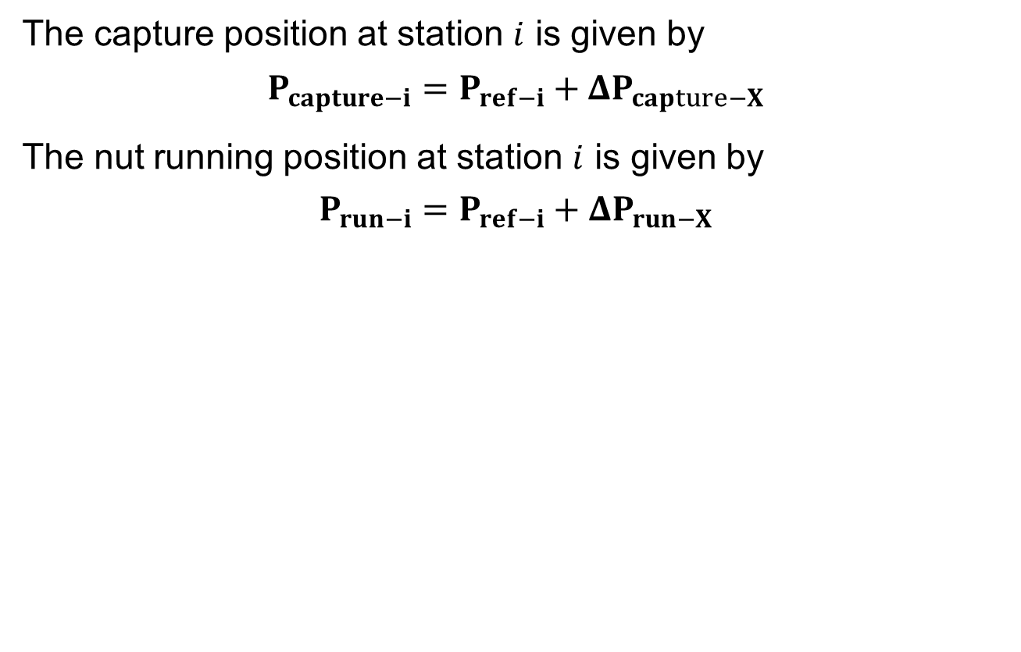
Capture, Run and Ref. Positions
System Design
The capture position at station $i$ is given by
$$P_{capture−i}=P_{ref−i}+ΔP_{capture−X}$$
The nut running position at station $i$ is given by
$$P_{run−i}=P_{ref−i}+ΔP_{run−X}$$

Slide 12
IMAGE PROCESSING ALGORITHM
★ My Golden Star 

Slide 13
How It Works
Image Processing

Slide 14
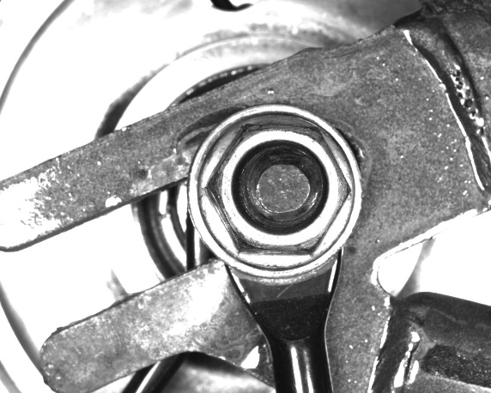



Detect the Nut in the Image (1/2)
Image Processing
(a) Origin Image
(b) Undistorted
(c) Gaussian blurred
(d) Otsu Thresholed
(e) Closing Transformed
(Inverted Image)
(Dilation followed by Erosion)

Slide 15
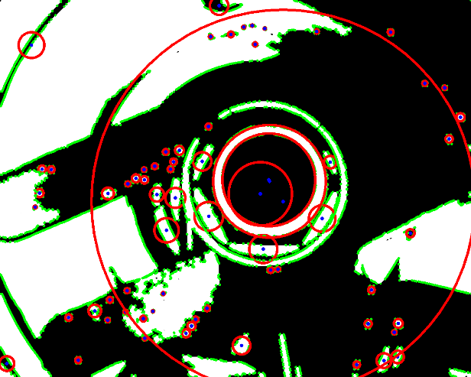
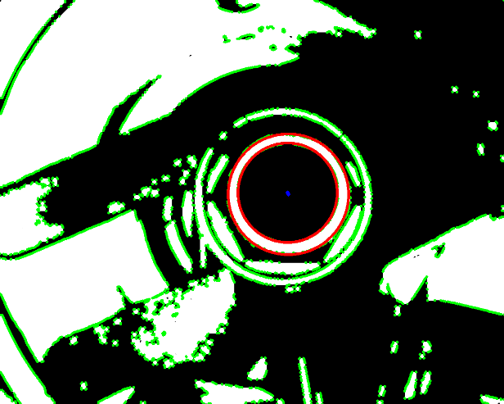

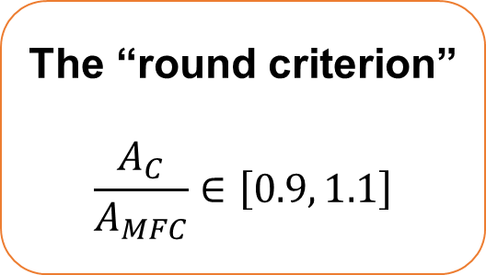
Detect the Nut in the Image (2/2)
Image Processing
(a) All contours and their min-fitting-circles
(b) Filter out the
“not round” contours.
(c) Final contour (using dimensional comparision)
The “round criterion”
$$\frac{A_{C}}{A_{MFC}}∈\left[0.9, 1.1\right]$$
Min Fitting Circle

Slide 16
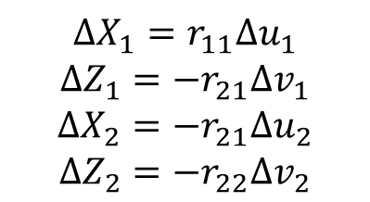
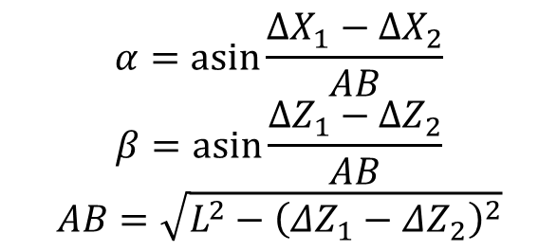
Estimate the Variations w.r.t the “Zero” Data.
Image Processing
Variations estimating diagram
$$α=\operatorname{asin}{\frac{ΔX_{1}−ΔX_{2}}{AB}}$$
$$β=\operatorname{asin}{\frac{ΔZ_{1}−ΔZ_{2}}{AB}}$$
$$AB=\sqrt{{L^{2}−\left(ΔZ_{1}−ΔZ_{2}\right)}^{2}}$$
$${ΔX}_{1}=r_{11}{Δu}_{1}$$
$${ΔZ}_{1}=−r_{21}{Δv}_{1}$$
$${ΔX}_{2}=−r_{21}{Δu}_{2}$$
$${ΔZ}_{2}=−r_{22}{Δv}_{2}$$

Slide 17
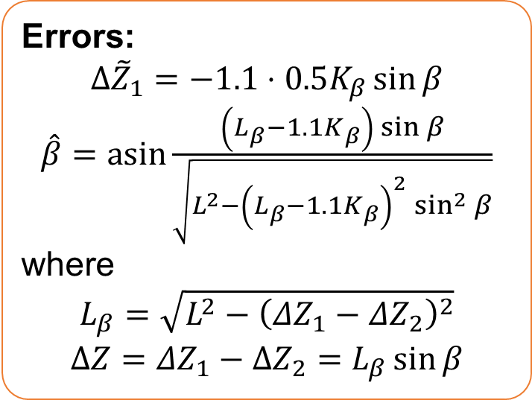
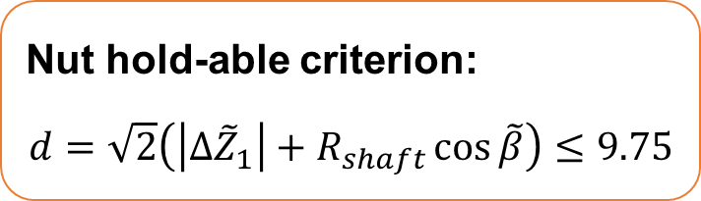
Error Examination
Image Processing
Nut hold-able criterion:
$$d=\sqrt{2}\left(\left|Δ{\tilde{Z}}_{1}\right|+R_{shaft}\cos{\tilde{β}}\right)≤9.75$$
“Nut hold-able criterion” diagram
Errors:
$$Δ{\tilde{Z}}_{1}=−1.1⋅0.5K_{β}\sin{β}$$
$\hat{β}=$ $\operatorname{asin}{\frac{\left(L_{β}−1.1K_{β}\right)\sin{β}}{\sqrt{L^{2}−{\left(L_{β}−1.1K_{β}\right)}^{2}\sin^{2}{β}}}}$
where
$$L_{β}=\sqrt{{L^{2}−\left(ΔZ_{1}−ΔZ_{2}\right)}^{2}}$$
$$ΔZ=ΔZ_{1}−ΔZ_{2}=L_{β}\sin{β}$$
Errors diagram.

Slide 18


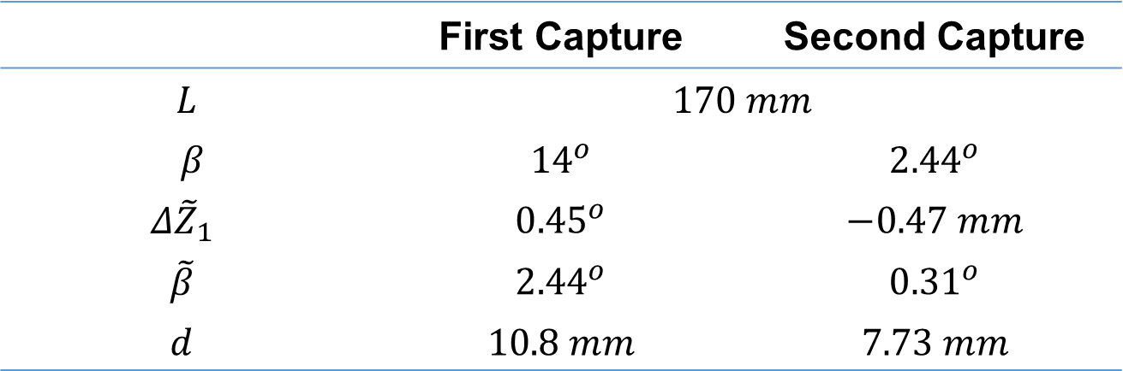

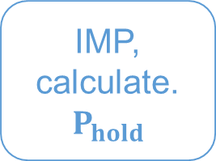
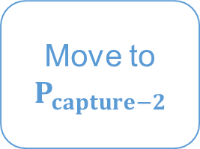
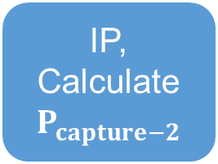
High Error Cases: Double Capturing Solution
Image Processing
IP: Image Processing
IP,
Calculate
$$P_{capture−2}$$
Move to
$$P_{capture−2}$$
IMP, calculate.
$$P_{hold}$$
Move to
$$P_{hold}$$
 | First Capture | Second Capture
$$L$$ | $$170 mm$$
$β$ | $${14}^{o}$$ | $${2.44}^{o}$$
$$Δ{\tilde{Z}}_{1}$$ | $${0.45}^{o}$$ | $$−0.47 mm$$
$$\tilde{β}$$ | $${2.44}^{o}$$ | $${0.31}^{o}$$
$$d$$ | $$10.8 mm$$ | $$7.73 mm$$

Slide 19
Auto Tunning Fuction
Image Processing
Lighting effect on nuts detection.
Auto Tunning Algorithm

Slide 20
Mechatronics Design
MECHANICAL AND
ELECTRIC/ELECTRICAL
DESIGN

Slide 21
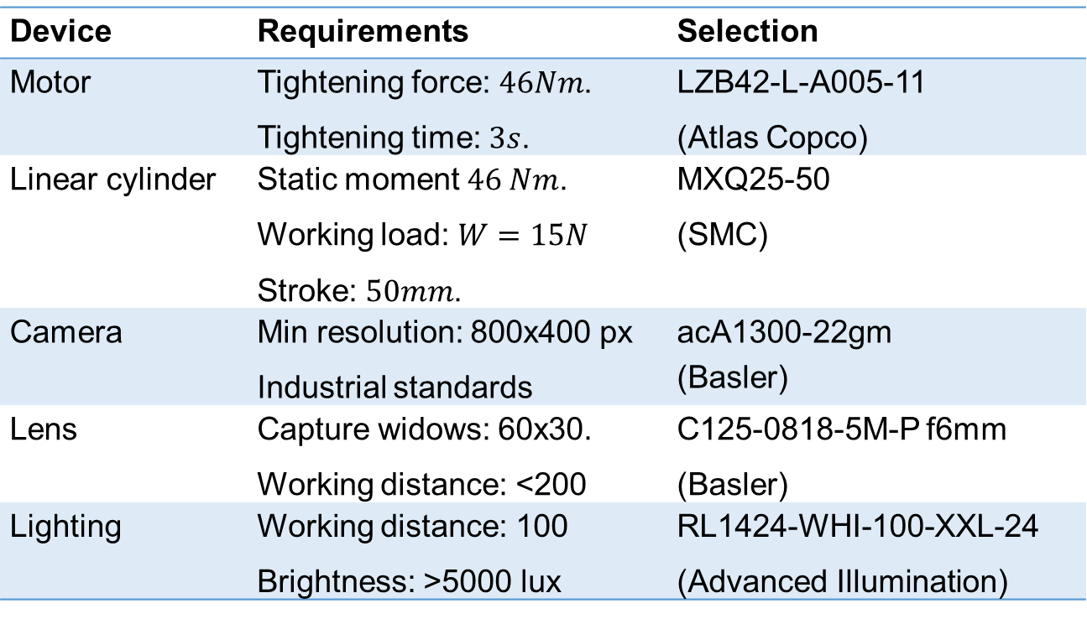
Robot’s Tool – Devices Selection
Mechatronics Design
Device | Requirements | Selection
Motor | Tightening force: $46Nm$. Tightening time: $3s$. | LZB42-L-A005-11 (Atlas Copco)
Linear cylinder | Static moment $46 Nm$. Working load: $W=15N$ Stroke: $50mm$. | MXQ25-50 (SMC)
Camera | Min resolution: 800x400 px Industrial standards | acA1300-22gm (Basler)
Lens | Capture widows: 60x30. Working distance: <200 | C125-0818-5M-P f6mm (Basler)
Lighting | Working distance: 100 Brightness: >5000 lux | RL1424-WHI-100-XXL-24 (Advanced Illumination)

Slide 22
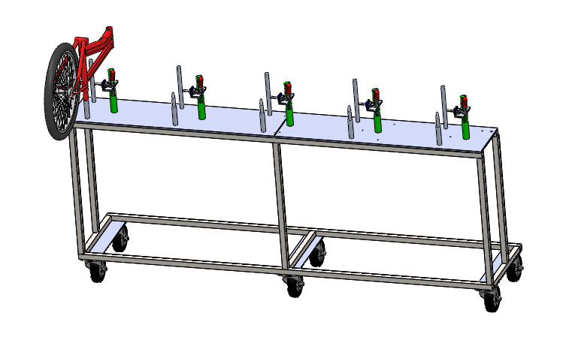
Mounting Cart Design
Mechatronics Design
Bike Mounting Principle

Slide 23
Electric/Electrical System Design
Mechatronics Design
Device | Requirements | Selection
Computer | Gigabit Ethernet (RJ45) Avaiable. RAM: 1GB. CPU: 2GHz, multithreading supported. OS supported | IPC-510 (Core i3) (AdvanTech )
PLC | Min: 2 digital inputs and 2 digital outputs Modbus TCP supported | S7-1200 CPU 1211C (Siemens)
HMI | Modbus TCP supported Min resolution: 7”. CPU min speed: 400 MHZ. | MT8071iP (Weintek)
Switch | Minimum 6 ports including: 2 ports PoE GigE 2 ports GigE 2 ports 100Mbps | IPS33064P (ONV)

Slide 24
System Performance
SYSTEM
PERFORMANCE
What do the Experiments Say?

Slide 25
Experiment Objective and Method
System Performance
Objective
examine the stability of the nut-holding position determination algorithm.
examine the processing time of the nut-holding position determination algorithm.
examine the working process to find if any risk might occur.
Phương án tổ chức thực nghiệm
Gá các xe đạp sao cho vị trí cốt đùm không thay đổi.
Cho hệ thống chạy tự động trong một thời gian (không cho xy lanh đi ra/siết ốc), ghi lại các kết quả xử lý ảnh (logging).

Slide 26

Experimental Video
Hiệu quả

Slide 27
Conclusions
CONCLUSIONS

Slide 28
Conclusions
Kết luận
Research Task:
The research task was completed, meeting the design requirements.
The design emphasizes the flexibility of the system.
Experimental results demonstrate the feasibility of the designed system.
Limitations:
The issue of automatic material feeding and removal has not been resolved.
The experiment was not conducted exactly according to the design specifications.
Cost optimization for the products has not been achieved.
The system's target audience is relatively small.

Slide 29
References
Tài liệu tham khảo
[1] Hadland Tony; Lessing Hans-Erhard, Bicycle Design_ An Illustrated History, London, England: The MIT Press, 2014.
[2] M. U.S.A, "Makita USA - Product Details -DFT124RZ," Makita U.S.A., Inc, [Online]. Available: https://www.makitaassemblytools.com/products/details/DFT124RZ. [Accessed 20 08 2020].
[3] Plarad, "Plarad - Electric nut runner," Maschinenfabrik Wagner GmbH & Co. KG, [Online]. Available: http://www.plarad.com/produkte/elektrische-drehschrauber/de1.html?L=1. [Accessed 20 08 2020].
[4] A. C. USA, "Power Focus 6000 - Atlas Copco USA," Atlas Copco North America LLC, [Online]. Available: https://www.atlascopco.com/en-us/itba/products/assembly-solutions/electric-assembly-systems/powerfocus-6000. [Accessed 20 08 2020].
[5] A. C. U.S.A, "RTP Pneumatic Nutrunner - Atlas Copco USA," Atlas Copco North America LLC., [Online]. Available: https://www.atlascopco.com/en-uk/itba/products/assembly-solutions/pneumatic-assembly-tools/pneumatic-nutrunners/rtp/rtp. [Accessed 20 08 2020].
[6] Zhang and Z., "A Flexible New Technique for Camera Calibration.," IEEE Transactions on Pattern Analysis and Machine Intelligence., vol. 22, no. 11, pp. 1330-1334, 2000.

Slide 30
References
[7] Mark Nixon; Alberto Aguado, Feature Extraction and Image Processing for Computer Vision, London: Academic Press, 2019.
[8] S. Satoshi and A. Keiichi, "Topological structural analysis of digitized binary images by border following," Computer Vision, Graphics, and Image Processing, vol. 30, no. 1, p. 32–46, 1985.
[9] D. Doug, "Advanced Illumination RL1424-660NI Axial LED Ring Light w/ Mounting Bracket," Doug Deals, [Online]. Available: https://www.dougdeals.com/advanced-illumination-rl1424-660ni-axial-led-ring-light-w-mounting-bracket/. [Accessed 19 08 2020].
[10] Das Biman; Wang Yanqing, "Isometric Pull-Push Strengths in Workspace: 1. Strength Profiles," International Journal of Occupational Safety and Ergonomics (JOSE), pp. Vol. 10, No. 1, 43–58, 2004.
[11] Yoycart, "The IPC-510 AIMB-501G2 on-board machine 2PCI with i3-2120 i3-3220.," Yoycart.com, [Online]. Available: https://www.yoycart.com/Product/551566748315/. [Accessed 01 09 2020].
[12] “CPU 1211C, DC/DC/DC, 6DI/4DO/2AI , 6ES7211-1AE31-0XB0,” EMIN, [Trực tuyến]. Available: https://emin.vn/siemens6di-4do-2ai-6es7211-1ae31-0xb0-cpu-1211c-dc-dc-dc-6di-4do-2ai-6es7211-1ae31-0xb0-3438/pr.html. [Đã truy cập 01 09 2020].
[13] I. F. o. Robotics, "Executive Summary World Robotics 2019 Industrial Robots," [Online]. Available: https://ifr.org/downloads/press2018/Executive%20Summary%20WR%202019%20Industrial%20Robots.pdf. [Accessed 27 08 2020].

